Slide 1

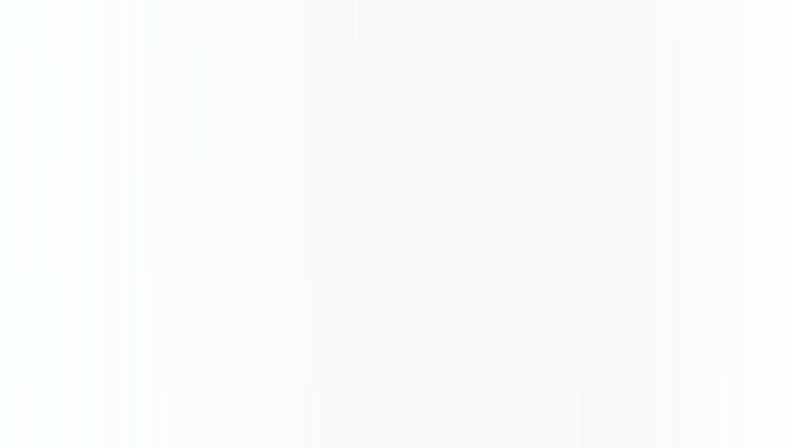
BA TECHNOLOGY, DATA, & INSIGHT
SKYTRAX AIRLINE
Predicting Customer Booking Completion – Machine Learning Insights
October 2022

Slide 2
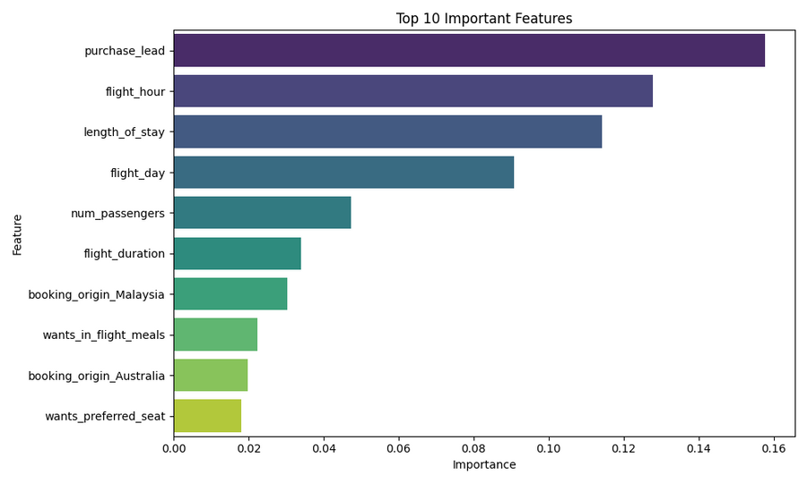

RESULTS
Summary of Predictive Modeling Task:
High accuracy model predicting booking completion (Accuracy: ~90%).
Top predictors:
purchase lead,
wants_extra_baggage,
wants_in_flight_meals.
Customers who added extra services were more likely to complete bookings.
Sales channel and route also influence conversion rate.
ROC AUC score of ~0.89 shows strong predictive power.
INFORMATION FOR BRITISH AIRWAYS INTERNAL USE ONLY
2

